Slide 1



Motilal Nehru National Institute of Technology Allahabad, Prayagraj
A COMPARATIVE STUDY OF VARIOUS MACHINE LEARNING APPROACHES IN PREDICTING EV CHARGE DEMANDS
Subject : B.tech Project
Course Code : EE17106
Presented By : Group 3
Chirag Srivastava (20202030)
Shreshtha Gupta (20206050)
Sandeep Oraon (20202072)
Project Supervisor :
Dr. Navneet Kumar Singh

Slide 2
CONTENTS
Motivation
Objective
Data Description and Methodology
Machine learning Models
Evaluation Metrics
Results
Conclusion
References

Slide 3
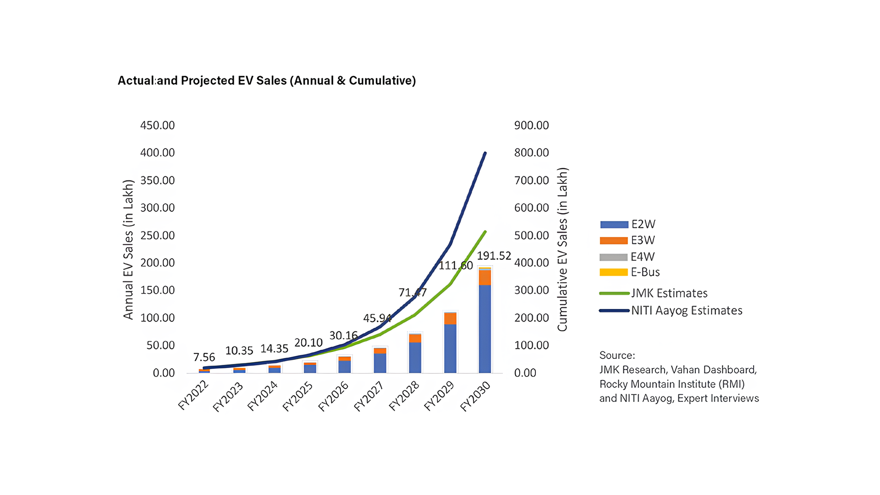
MOTIVATION
The adoption of electric vehicles (EVs) is growing rapidly, driven by environmental concerns and government incentives.
As per the data provided by the Union Minister and sourced from the government’s Vahan website, there are over 2.8 million registered electric vehicles (EVs) – 28,30,565 units – on Indian roads as of August 3, 2023.[21]
Fig. 1: EV sales in India[19]
Notes:
The Indian government aims to have EVs comprise 30% of new private vehicle registrations, amounting to 8 crore EVs, by 2030. To support this dramatic rise in EV adoption, India will need a total of 39 lakh public and semi-public charging stations for a ratio of 1 station per 20 vehicles.

Slide 4
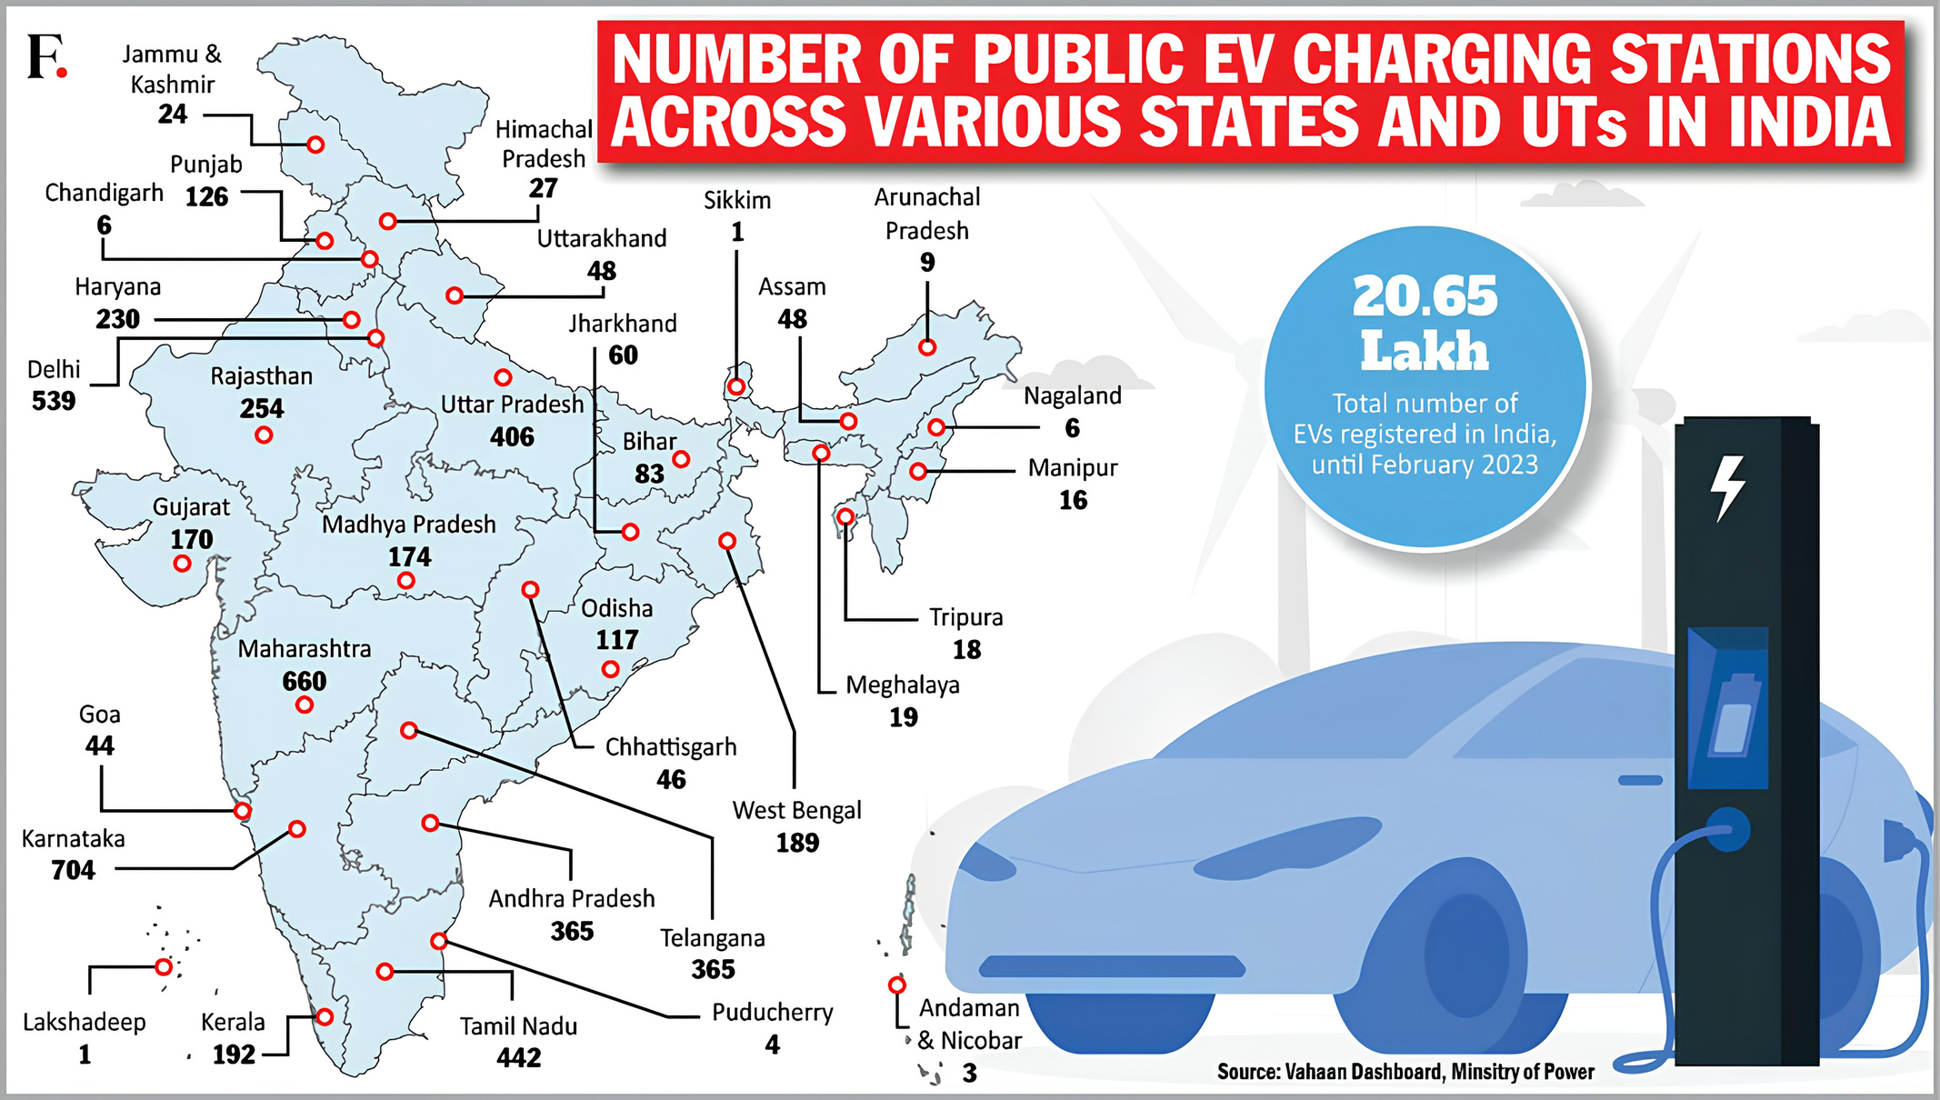
The country has installed 8,738 operational public electric vehicles charging stations as of June 30, 2023, according to the Bureau of Energy Efficiency (BEE) and the Ministry of Power data.[22]
Fig. 2: Number of EV charging stations in India[20]
Notes:
-The ratio of Cs to EVs in India is 1:135, which is much lower than the global average of 1:6.
- To ensure that the grid can meet the growing demand for electricity from EVs, it is important to accurately predict the electricity required for charging EVs at charging stations.
- Predicting EV charging demand will help to better manage the load on the power grid and maintain stability during peak demand periods.
-This reduces the risk of strain on the grid, minimizes the need for expensive infrastructure upgrades, and contributes to a more resilient and efficient power system

Slide 5
OBJECTIVE
This project aims to propose accurate models for predicting EV charging demand at charging stations.
Train machine learning models on historical data of EV charging sessions and other factors.
Compare the performance of different machine learning approaches, including Transformers, N-BEATS, LSTM, and SVM models, to identify the most effective method for predicting EV charge demand.
Gain insights into the factors influencing EV charging patterns. By successfully predicting EV charging demand, we can contribute to a more efficient and sustainable transportation system.

Slide 6
VARIOUS PREDICTION APPROACHES
Support Vector Machine(SVM)
Long-Short Term Memory(LSTM)
N-Beats
Transformer
Notes:
- The significance of time series prediction lies in its ability to uncover hidden patterns,
trends, and dependencies within temporal data. By analyzing historical information, predictive models can be built to anticipate future values, enabling informed
decision-making and proactive planning.

Slide 7
DATA DESCRIPTION AND METHODOLOGY
The ACN-Data dataset is a publicly available repository of over 30,000 EV charging sessions meticulously compiled from two workplace charging sites in California
The dataset contains charging records from two stations in the university campus, namely JPL and Caltech.
Features like connectionTime, doneChargingTime, disconnectTime, timezone, requestedDeparture, kWhrequested are in the dataset.
The k-nearest neighbors (KNN) imputation method was employed to fill in the missing values
Notes:
--To assess the models’ generalization capabilities, the data was partitioned into training, validation, and testing
sets, adhering to a 0.75:0.10:0.15 ratio.
--. Furthermore, scaling was applied to the data, normalizing its distribution and improving
the convergence of the machine-learning algorithms.

Slide 8
Machine Learning Models
SUPPORT VECTOR MACHINE(SVM):
In this work, the target variables, i.e., the session duration and the energy consumption, are both labelled, and thus, supervised learning will be used.
Two primary methodologies exist for employing SVMs in time series prediction: Support vector regression (SVR) and support vector classification (SVC).
Since both target variables are continuous values, we used regression models as opposed to classification models, which deal with categorical target values.

Slide 9
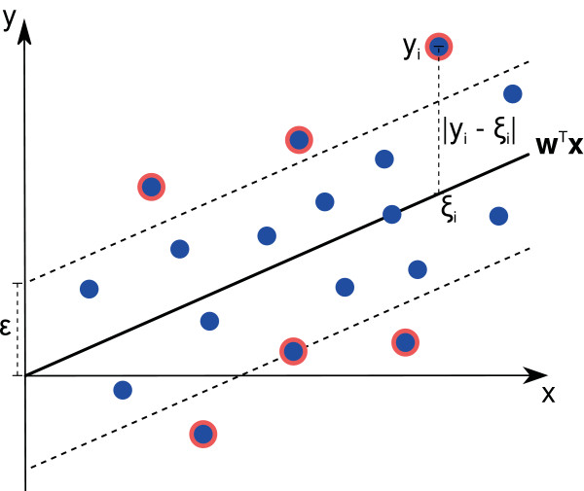
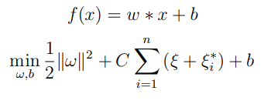
Where:
(w) : the weight vector defines the coefficients associated with each feature
(b) : bias term
(ϵ) : error margin in plane
(ξ) : deviations beyond the error margin
(C) : controls the trade-off between a smooth hyperplane and minimizing errors
Fig.3: SVR
Notes:
SVRs offer several advantages for time series prediction, including their ability
to capture nonlinear relationships in the data, their robustness to outliers, and their
generalization capabilities. However, SVRs can be computationally expensive to
train, especially for large datasets, and require careful parameter selection.

Slide 10
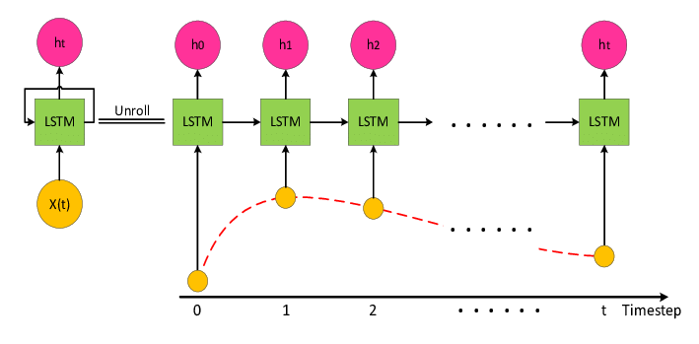
LONG SHORT TERM MEMORY(LSTM):
LSTMs are particularly well-suited for time series prediction because they are made to handle sequential data. Long-term dependencies in data are efficiently captured by LSTMs, which solves the vanishing gradient issue that traditional RNNs have.
Fig 4: LSTM architecture for time series data

Slide 11
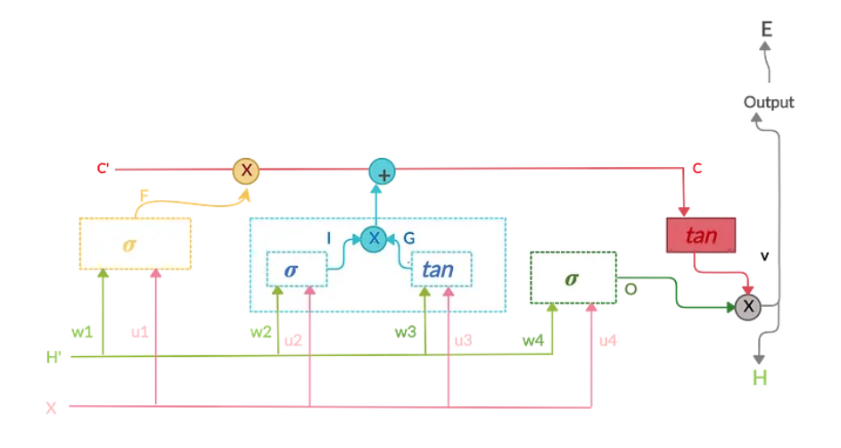
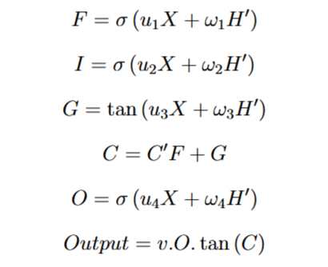
Fig.5: Internal structure of a unit LSTM cell

Slide 12
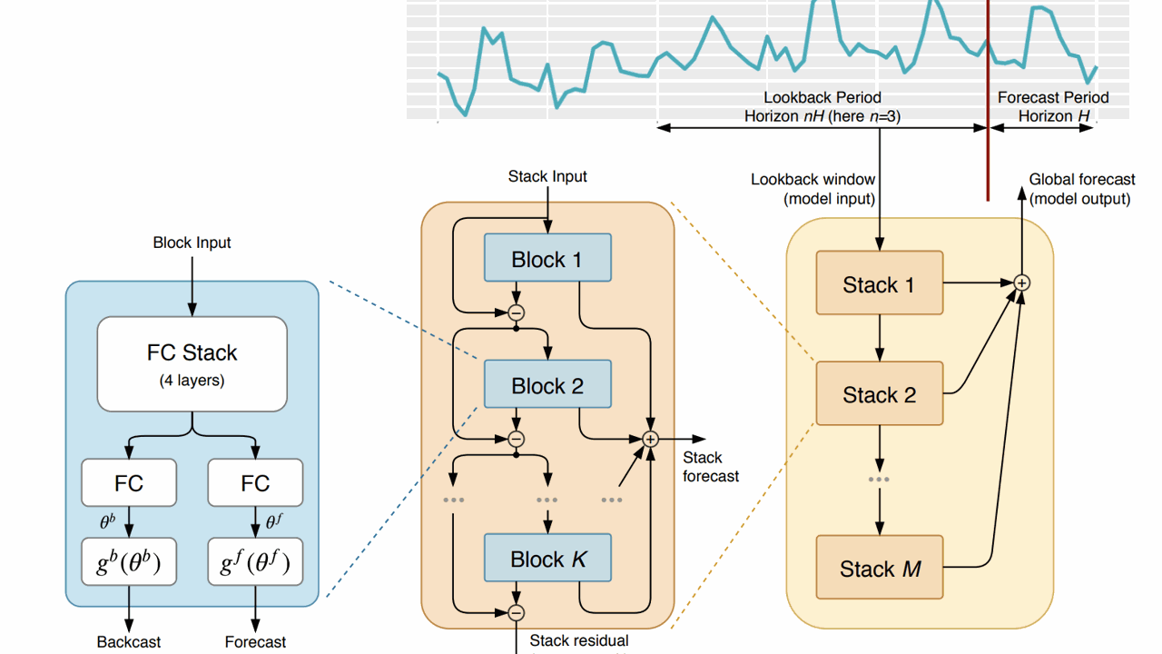
NEURAL BASIS EXPANSION ANALYSIS FOR INTERPRETABLE TIME SERIES (N-BEATS)
Fig. 6: N-Beats Model for Time Series Prediction

Slide 13
N-Beats Model:
The N-BEATS architecture consists of three primary components: stacks, blocks, and expansion layers
Stacks are arranged in a hierarchical manner, with each stack responsible for capturing different temporal frequencies in the time series data.
Blocks consist of fully connected layers followed by residual connections, allowing for efficient information flow and preventing vanishing gradients.
Expansion layers transform the input sequence into a higher-dimensional representation, enabling the model to capture more complex patterns in the data.
Notes:
--The working mechanism of N-BEATS involves sequentially processing the input time
series data through the stacked blocks. Each stack extracts relevant information and
refines the forecast, with the outputs of different blocks combined through residual
connections. Basis expansion layers enhance the model’s ability to capture complex
nonlinear relationships in the data. The final output of N-BEATS is a forecast of the
future values of the time series generated by combining the outputs of all stacks.
-- Its interpretability is a distinctive feature, enabling
users to discern the contributions of individual components.

Slide 14
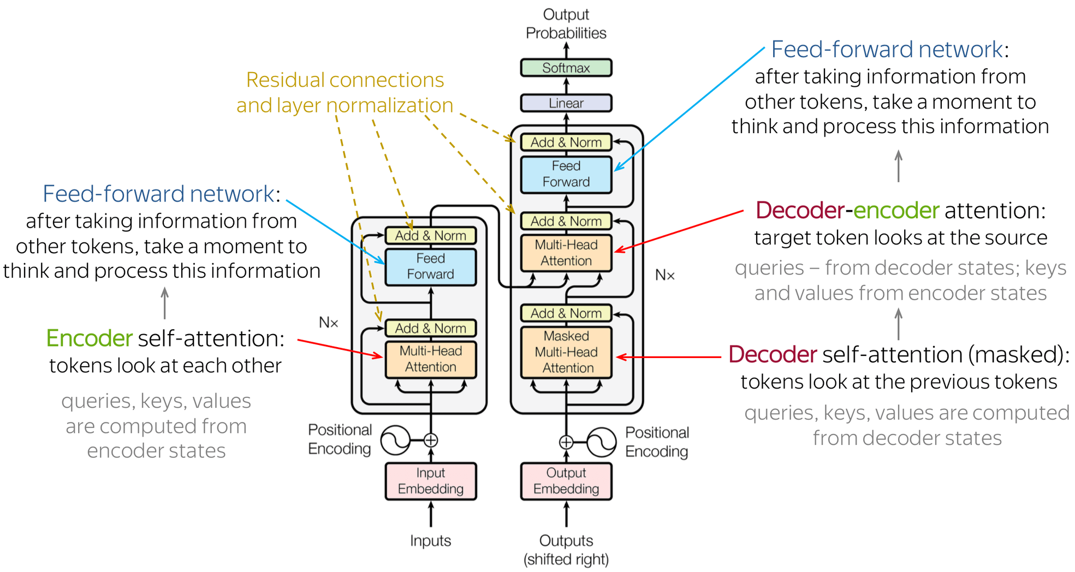
TRANSFORMER:
Fig.7: Transformer Architecture

Slide 15
The transformer neural network aims to solve sequence-to-sequence tasks while handling long-range dependencies with ease.
The transformer model consists of two main components: an encoder and a decoder.
The encoder takes an input sequence of tokens and maps it into a sequence of continuous representations.
The decoder then takes the encoder output and generates an output sequence of tokens.
The transformer model does not use recurrent connections, which can suffer from the vanishing gradient problem. Instead, the transformer model uses positional encoding to add information about the relative positions of the tokens in the input and output sequences.

Slide 16
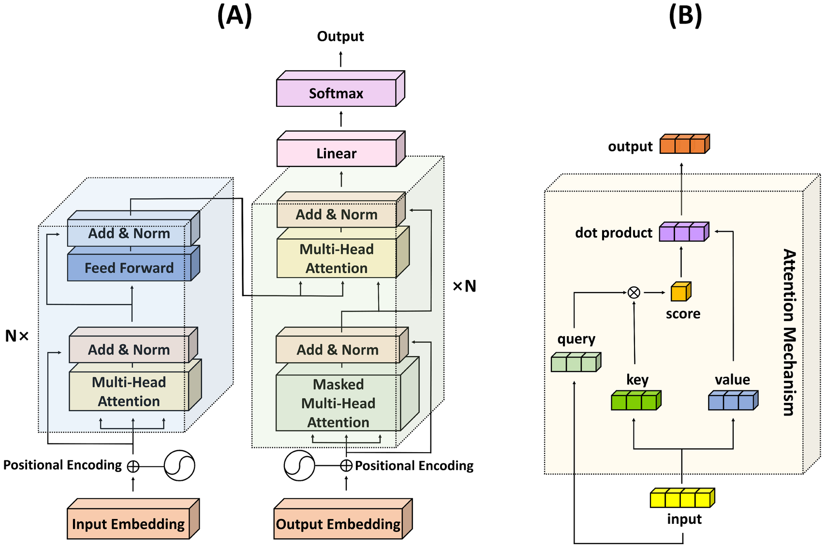
Fig. 8: Calculation of Multihead Attention in Transform

Slide 17
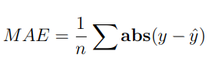
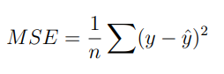
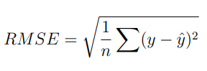
Evaluation Metrics
Mean Absolute Error(MAE): It measures the average absolute difference between the predicted values and the actual values.
Mean Square Error(MSE): Mean squared error states that finding the squared difference between actual and predicted value.It represents the squared distance between actual and predicted values.
Root Mean Squared Error(RMSE): It is the square root of MSE.

Slide 18
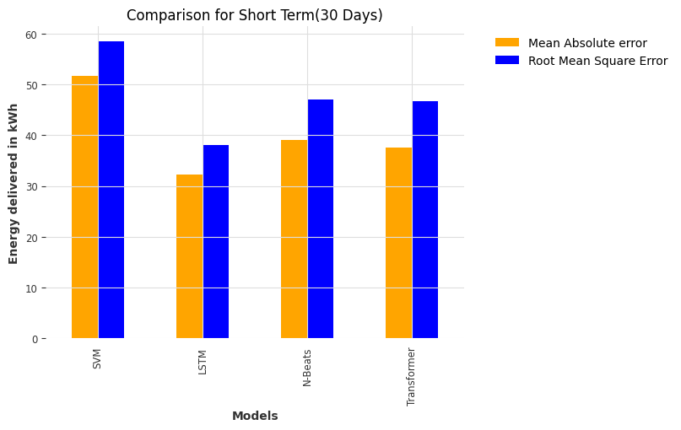
RESULT
SHORT TERM PREDICTION (30 DAYS):
Fig. 9: Comparision of various approches , considering a period of 30 days

Slide 19
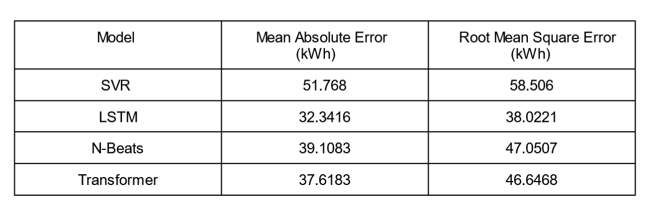
Table 1: Comparison of models for 30 days prediction

Slide 20
LSTM emerged as the frontrunner, consistently outperforming the other models across various metrics.
N-BEATS and SVR followed closely behind, demonstrating their effectiveness in predicting EV charging demand.
The Transformer model, while not as dominant as the leading models, still exhibited promising prediction capabilities. Interestingly, all models successfully captured the underlying charging patterns and provided predictions with good accuracy.

Slide 21
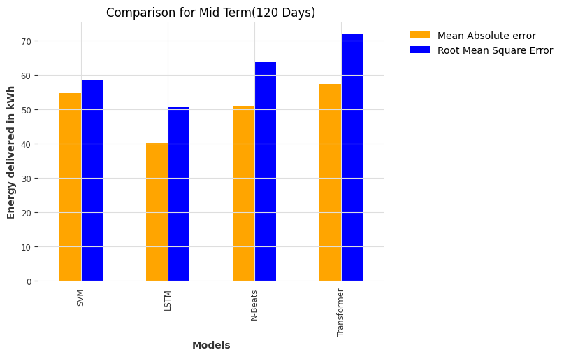
MID TERM PREDICTION (120 DAYS):
Fig. 10: Comparision of various approches , considering a period of 120 days

Slide 22
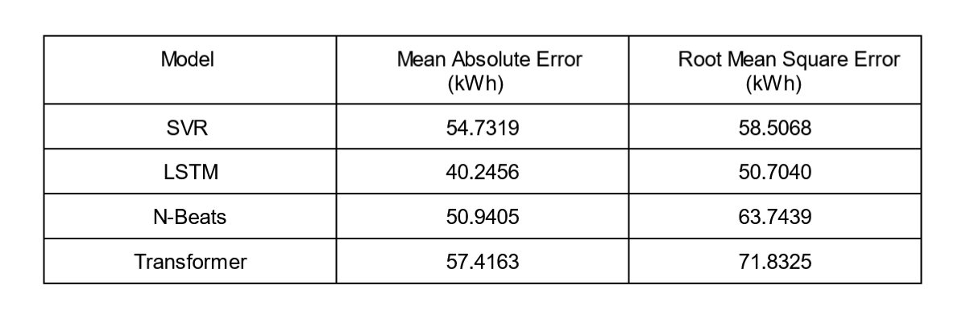
Table 2: Comparison of models for 120 days prediction

Slide 23
LSTM’s dominance in terms of quantitative metrics consistently outperforms the other models in evaluation metrics.
SVR closely followed, demonstrating its efficiency in prediction tasks.
N-BEATS and Transformer, while not as strong in overall metrics, exhibited unique strengths. Notably, Transformer excelled in pattern recognition, effectively capturing subtle trends and nuances in the charging behaviour.

Slide 24
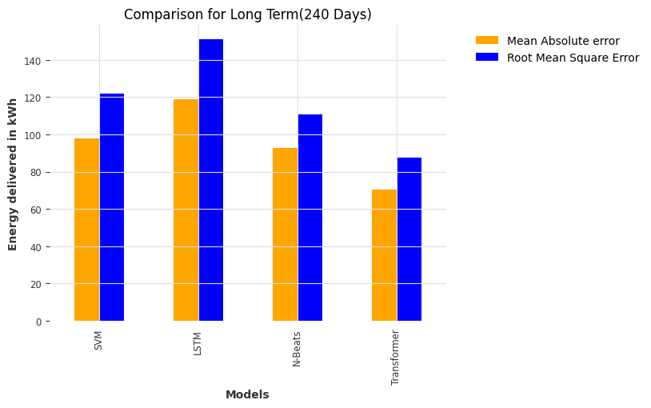
LONG TERM PREDICTION (240 DAYS):
Fig. 11: Comparision of various approches , considering a period of 240 days

Slide 25
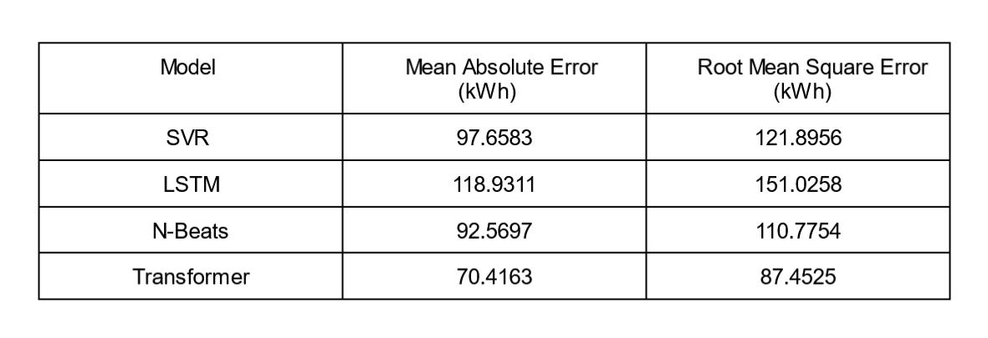
Table 3: Comparison of models for 240 days prediction

Slide 26
Long-range dependencies are harder for LSTM to capture.
By comparison, the Transformer comes out on top as it consistently makes accurate and insightful predictions over long periods of time.
SVR, while promising for pattern recognition in long-term predictions, still lags behind the Transformer’s overall performance.
N-BEATS, despite its potential for medium-term prediction, struggles to maintain accuracy over extended periods.
These results confirm that the Transformer is the best option for predicting long-term charging demand.
Notes:
--Long-range dependencies are harder for LSTM to capture as the time horizon gets longer, which makes it less useful for predicting long-term EV charging demand.
--Its capacity to accurately represent intricate relationships and temporal dependencies in the time series data is the source of its exceptional accuracy and pattern recognition abilities

Slide 27
Conclusion
In this report, we have evaluated various prediction models for EV charging demand and proposed the Transformer as the most suitable choice for long-term predictions.
While other models, such as SVR and N-BEATS, exhibit promising capabilities for medium-term prediction, their performance falters as the time period extends.
LSTM, while effective for short-term predictions, falls short in capturing long-range dependencies.

Slide 28
REFERENCES
[1] Kim, Y.; Kim, S. Forecasting Charging Demand of Electric Vehicles Using Time-
Series Models. Energies 2021, 14, 1487. https://doi.org/ 10.3390/en140514871
[2] Cheon, S.; Kang, S.-J. An electric power consumption analysis system for the
installation of electric vehicle charging stations. Energies 2017, 10, 1534
[3] Lee, D.-H.; Kim, M.-S.; Roh, J.-H.; Yang, J.-P.; Park, J.-B. Forecasting of Elec-
tric Vehicles Charging Pattern Using Bayesians method with the Convolustion.
IFAC-PapersOnLine 2019, 52, 413–418
[4] Amini, M.H.; Kargarian, A.; Karabasoglu, O. ARIMA-based decoupled time
series forecasting of electric vehicle charging demand for stochastic power systemoperation. Electr. Power Syst. Res. 2016, 140, 378–390.
[5] Majidpour, M.; Qiu, C.; Chu, P.; Pota, H.R.; Gadh, R. Forecasting the EV
charging load based on customer profile or station measurement? Appl. Energy
2016, 163, 134–141

Slide 29
[6] Sun, Q.; Liu, J.; Rong, X.; Zhang, M.; Song, X.; Bie, Z.; Ni, Z. Charging load
forecasting of electric vehicle charging station based on support vector regression. In Proceedings of the 2016 IEEE PES Asia-Pacific Power and Energy Engineering Conference (APPEEC), Xi’an, China, 25–28 October 2016
[7] Lu, K.; Sun, W.; Ma, C.; Yang, S.; Zhu, Z.; Zhao, P.; Zhao, X.; Xu, N. Load
forecast method of electric vehicle charging station using SVR based on
GA-PSO. IOP Conf. Ser. Earth Environ. Sci. 2017
[8] Zhu, J.; Yang, Z.; Mourshed, M.; Guo, Y.; Zhou, Y.; Chang, Y.; Wei, Y.; Feng,
S. Electric vehicle charging load forecasting: A comparative study of deep learning approaches. Energies 2019, 12, 2692
[9] Li, Y.; Huang, Y.; Zhang, M. Short-term load forecasting for electric vehicle
charging station based on niche immunity lion algorithm and convolutional neural network. Energies 2018, 11, 1253.

Slide 30
[10] Zhao, W.; Dai, T.-T.; Wang, L.-C.; Lu, K.; Chen, N. Short-term Load Fore-
casting Considering Meteorological Factors and Electric Vehicles. IOP Conf. Ser.
Mater. Sci. Eng. 2018, 439, 032114
[11] Zhu, J.; Yang, Z.; Mourshed, M.; Guo, Y.; Zhou, Y.; Chang, Y.; Wei, Y.;
Feng, S. Electric vehicle charging load forecasting: A comparative study of deep
learning approaches. Energies 2019, 12, 2692
[12] Prediction of EV Charging Behavior Using Machine Learning by SAKIB
SHAHRIAR, published August 2021
[13] Hinton, G.E.; Osindero, S.; Teh, Y.W. A fast learning algorithm for deep belief
nets. Neural Comput. 2006, 18, 1527–1554
[14] Attention Is All You Need; Ashish Vaswani, Noam Shazeer, Niki Parmar, Jakob
Uszkoreit, Llion Jones, Aidan N. Gomez, Lukasz Kaiser, Illia Polosukhin. Pub-
lished 2017.

Slide 31
[15] Koohfar, S.; Woldemariam, W.; Kumar, A. Prediction of Electric Vehicles
Charging Demand: A Transformer-Based Deep Learning Approach.
Sustainability 2023, 15, 2105. https://doi.org/10.3390/ su15032105
[16] Boris N. Oreshkin, Dmitri Carpov, Nicolas Chapados, Yoshua Bengio; N-Beats:Neural Basis Expansion Analysis For Interpretable Time Series Forecasting. ICLR 2020.
[17] Z. J. Lee, T. Li, and S. H. Low, “ACN-data: Analysis and ap-
plications of an open EV charging dataset,” in Proc. 10th ACM Int.
Conf. Future Energy Syst., New York, NY, USA, 2019, pp. 139149, doi:
https://doi.org/10.1145/3307772.3328313
[18] ACN-DataA Public EV Charging Dataset. Accessed: Jul. 2, 2020. [Online].
Available: https://ev.caltech.edu/dataset

Slide 32
[19] https://cleanmobilityshift.com/policy-regulation/india-must-accelerate-its-efforts-to-meet-the-projections-of-2030-ev-penetration/
[20] https://www.firstpost.com/india/indian-ev-charging-infrastructure-standardisation-destination-charging-12764802.html
[21] https://pib.gov.in/PressReleasePage.aspx?PRID=1947389
[22] https://pib.gov.in/PressReleasePage.aspx?PRID=1941444

Slide 33
THANK YOU

